Slide 1
Implementing QbD like other industries – Successfully!
FDA/Xavier University PharmaLink Conference
Cintas Centre, March 13 2013
Presented by: Hedley Rees, Managing Consultant
PharmaFlow Ltd
Notes:
Linked with Gary on LinkedIn
Said yes, but not sure what it was about
Other told me what an important conference it was
Honoured to be here

Slide 2
AGENDA
A brave new world?
Where are we now?
Modernization – the route to salvation?
What COULD the future hold?
Notes:
Writing book
Maufg & supply base of this sector has many issues before it
Talking about shortcomings in sc performance – quality, cost and delivery lead time
heparin unfolding simultaneously
That is not the only reason – also personal ones
Then will cover the industry dynamic which has got us here
The current state of play
The role of regulatory modernization
…then some ideas on what we can take from other secotors

Slide 3
The world of Pharma has changed!
generic alternatives
growth of biologics
regenerative medicine
stratified medicine
orphan drugs
personalized medicines
…etc, etc?
Notes:
Writing book
Maufg & supply base of this sector has many issues before it
Talking about shortcomings in sc performance – quality, cost and delivery lead time
heparin unfolding simultaneously
That is not the only reason – also personal ones
Then will cover the industry dynamic which has got us here
The current state of play
The role of regulatory modernization
…then some ideas on what we can take from other secotors

Slide 4
The world has changed
Installment payment plans
Used car trade-ins
Sedan-type body
Changing models yearly
Improved roads
Notes:
Writing book
Maufg & supply base of this sector has many issues before it
Talking about shortcomings in sc performance – quality, cost and delivery lead time
heparin unfolding simultaneously
That is not the only reason – also personal ones
Then will cover the industry dynamic which has got us here
The current state of play
The role of regulatory modernization
…then some ideas on what we can take from other secotors

Slide 5
Question?
Pharma is so totally different to sectors like semi-
conductor (computer chips) and automotives that it
is impossible to replicate their ways of working:
Yes
No
Don’t know
Notes:
Writing book
Maufg & supply base of this sector has many issues before it
Talking about shortcomings in sc performance – quality, cost and delivery lead time
heparin unfolding simultaneously
That is not the only reason – also personal ones
Then will cover the industry dynamic which has got us here
The current state of play
The role of regulatory modernization
…then some ideas on what we can take from other secotors

Slide 6
Where are we now?

Slide 7
Pharma as it was, and now is…
1970s
  Vertical integration
  Local presence in the company market
  Mainly small molecule
2010s
  innovator, virtual, biotech, generic/bio-similars, speciality Pharma
  Biologics
  Markets and supply locations globalize

Slide 8
The vicious circle of outsourcing
Mass outsourcing
Rapid expansion of contractor base
Rise of Virtual pharma
Drives growth in contractors
Drive s growth in
Virtual Pharma
Innovations cost ‘real’ money
Disconnection
Control over lead times
Tactical, arms length
Price escalation from lock-in
Opportunities for error

Slide 9
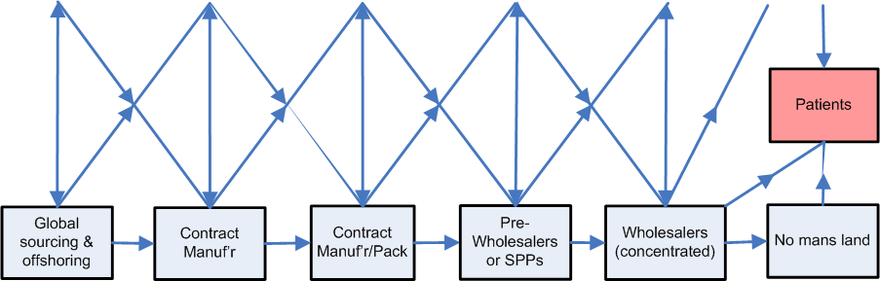
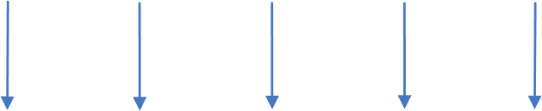

Dis-integration of the supply chain
Outsourcing begins in earnest…..

Slide 10

What my ‘Friends’ think
"Why don't we place the actual ranges on drug bottles?"on 81 mg aspirin, the label would state: "dose between 72.9 and 89.1 mg.”
Experts say as much as one-quarter of ingredients purchased in China by Western companies come from unknown sources.”
if Airlines had similar process capability to pharma …would have 2 crash landings per day at most major airports
Notes:
These are taken form FOMDI – say who they are
Basic principle is that generally accepted oharma works between 2 or 3 sigma – 70,000 defect per million

Slide 11
What my ‘Friends’ think (cont’d)
imagine the chaos in our supermarkets if food and beverage companies generated the same percentage of recalls that pharma does ?
Coke and Pepsi, made with pharma process capability may taste the same more often than not! Or they would have merged by now and be called Pepsi-Coke!
If salt in food had the same API content variation as a drug tablet ....it would range from flavorless to inedible

Slide 12
Complexity abounds…
Notes:
3 suppliers of each starting material – just in case
1 supplier of API – with 1 coming on board
No supplier of DP – coming on board….
No packaging supplier(s)… and launch approaching….

Slide 13
Information, information, information….
Notes:
Different groups at each contactor
Number of documents – duplication, opportunities for error
Technical agreements, supply agreements

Slide 14
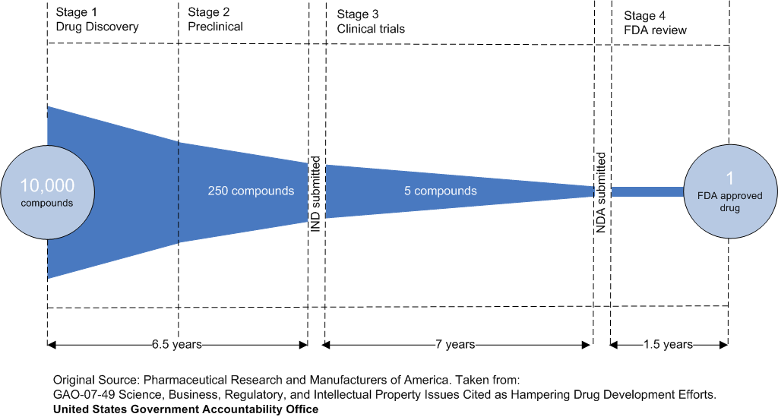
The patent ‘starting pistol’
Bang!!!
The starting pistol initiates behaviours aimed at reducing financial impact of failures and preparing for a race to approval
Notes:
Picture of the frighteningly high attrition rates and timescales involved
Somewhere in early stage research molecule is patents – gun goes off and raced for the clinic

Slide 15



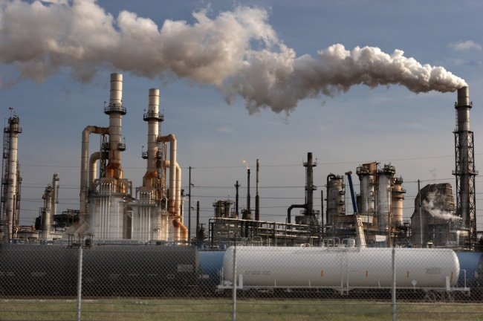
The find it, file it, flog it approach….
Eureka!
…seems to be
…seems to be
Is it safe?
Is it active?
Let’s get into the clinic – FAST!
…better make some for tox studies then….
Notes:
This is the series of events…..in exaggerated form
I call it the find it, file it , flog it approach

Slide 16
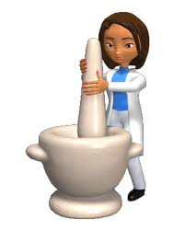



Enter the patent fairy…
Better make a batch for pre-clinical then
Bye bye my baby
Hope she realises I’ll be watching her…

Slide 17
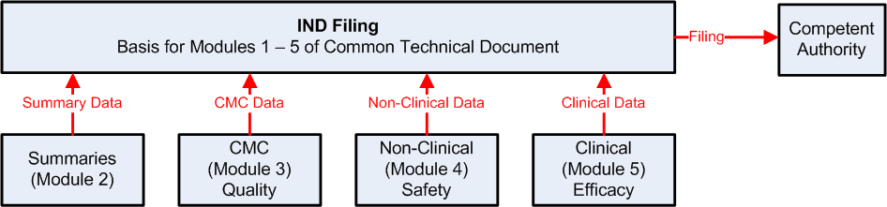
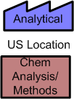
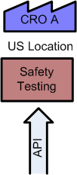
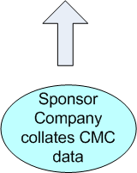
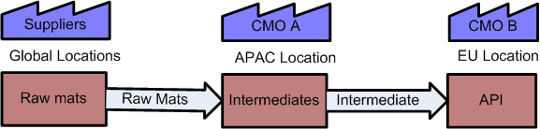
Making enough for pre-clinical
Supply chain thinking?
Notes:
Now let us assume the safety testing is successful and we are bound for the clinic

Slide 18
Where are we now?

Slide 19
Modernization – the route to salvation?

Slide 20
The 21st Century Initiative
  Pharmaceutical cGMP’s for the 21st Century – A Risk-Based Approach:
  Started 2002 and reported late 2004
  Desired state:
  “A maximally efficient, agile, flexible pharmaceutical manufacturing sector without extensive regulatory oversight.”
  Dr. Janet Woodcock, the U.S. Food and Drug Administration's Deputy Commissioner for Operations

Slide 21
Quality by Design (ICH Q8) and PAT
  QbD Concepts
    Quality should be built in by design
    Focus on product knowledge and process understanding
    Establishment of design space
  Provide opportunities for flexible regulatory approaches
    Risk-based regulatory decisions
    Real-time quality control and less release testing
    Process improvement within design space without further review
    Reduction in post-approval submissions
  PAT tools facilitates introduction of QbD

Slide 22
History of industrial improvement
Industrial Engineering
Total Quality Management (TQM)
World Class Manufacturing (WCM)
Theory of Constraints (ToC)
Lean and 6 sigma
Toyota Production System (TPS)
Systems Thinking
Deming wrote the book!

Slide 23
Lean background
NUMMI study, Womack & Jones “The Machine That Changed the World”
Based on Toyota Production System (TPS)
Reduce time between getting order and money in
  Respect for people
  Continuous improvement
Five principles
Many parallels with TQM, WCM, TOC, etc.
Relate to modernization

Slide 24
Five Principles of Lean
1. Specify value from the standpoint of the end customer by product family.
2. Identify all the steps in the value stream for each product family, eliminating whenever possible those steps that do not create value.
3. Make the value-creating steps occur in tight sequence so that the product will flow smoothly toward the customer.
4. As flow is introduced, let customers pull value from the next upstream activity.
5. As value is specified, value streams are identified, wasted steps are removed, and flow and pull are introduced, continue until a state of perfection is reached in which value is created with no waste.

Slide 25
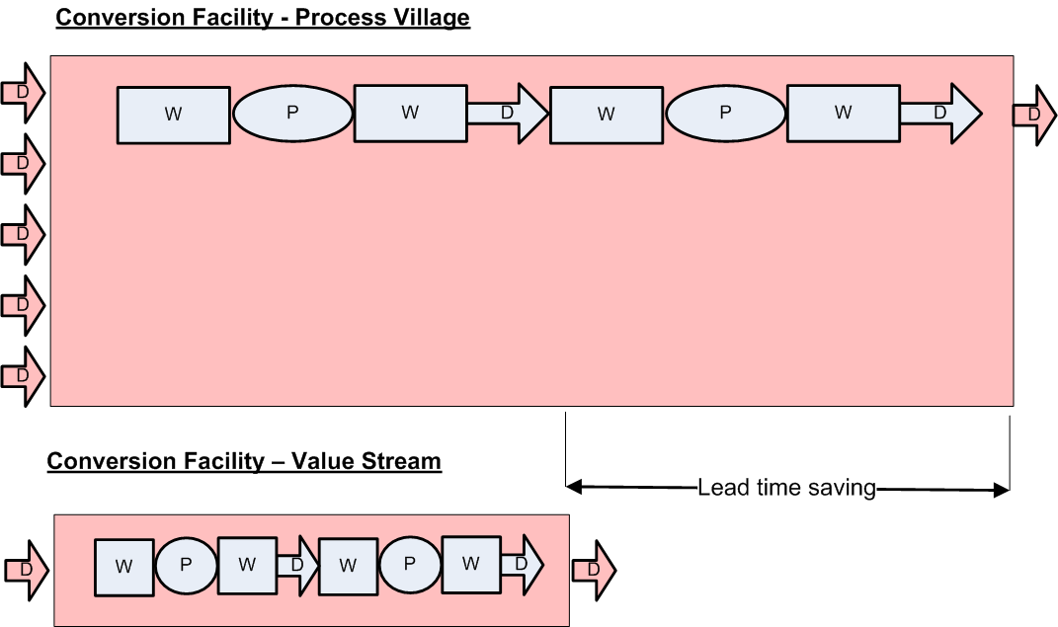
Process Village v Value Stream

Slide 26
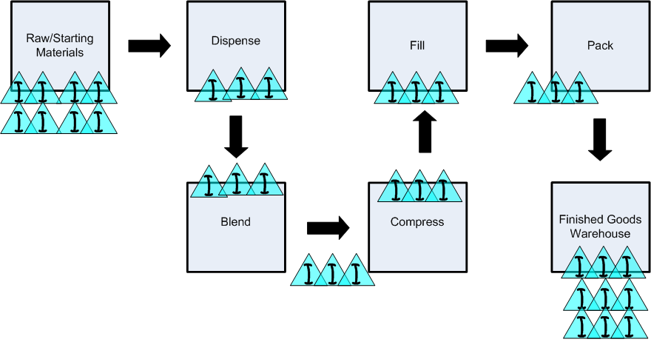
Traditional functional layout– solid dose
Key points:
Large batches
Produce to forecast
High in-process inventory
Defects are hidden

Slide 27
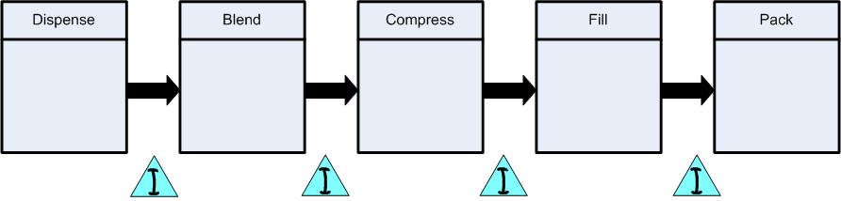
Value stream alignment – solid dose
Key points:
Schedule pacemaker only.
Set rate at TAKT (Production rate required to match rate of consumption in the market place.
Pull from the pacemaker (Kanbans and supermarkets)
Solve production problems (A3 Management)
Take out variation (SPC).
Reduce defect rates on incoming materials.
Use Single Minute Exchange of Dies (SMED) to reduce cycle time

Slide 28
What COULD the future hold?

Slide 29
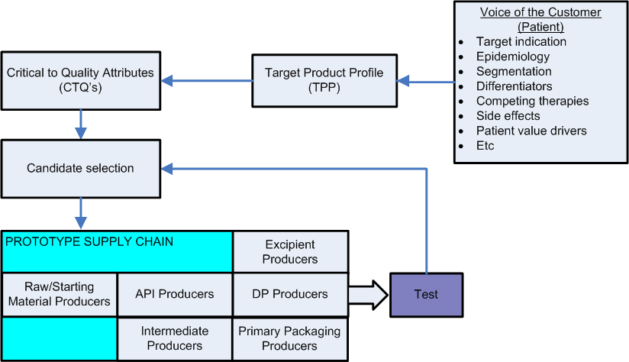
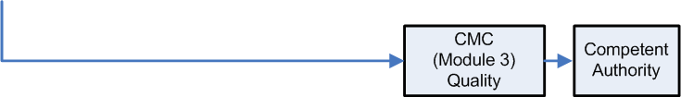
Overview of a development process
Safety
Efficacy
Quality

Slide 30
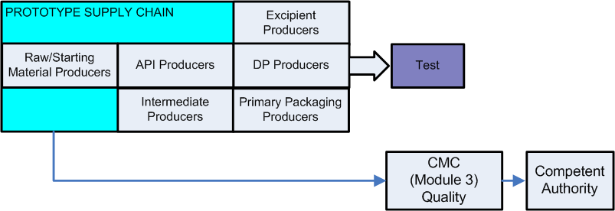
Principles of Prototyping
Design prototype based on full stakeholder involvement, including marketing, manufacturing, procurement, key suppliers
Allocate overall management responsibility for the programme
Discovery research stays with prototype testing - iterative
Focus on manufacturability of compounds using predictive methods
Build a deep understanding of material and process capability
Institutionalise risk management into development programmes
Build an outline of the end-to-end supply chain

Slide 31
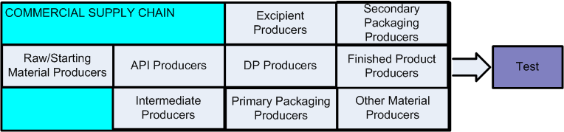
Principles of Commercial Supply
GMP/GDP mind-set from the start: Good Supply-chain Practice - GSP
Change emphasis from validation to process understanding/capability
Place responsibility for defective work on the producers not the quality function
Re-define the role of ‘quality’ into improvement activities
Deploy PAT
Become ‘business process’ oriented and quality systems aware
Institutionalise risk management into supply chain
Safety
Efficacy
Quality

Slide 32
Some radical concluding thoughts
Turn the development process on its head – put patient-use first
Don’t award patents for molecules until they are working prototypes
Supply chain for clinic and the market should be under one responsibility - with strong SCM competencies
Teach SCM principles at University to our chemists, pharmacists etc.
The IND/CTA CMC review process should require a higher level of understanding of the compound and it’s manufacturability

Slide 33
More radical concluding thoughts
Companies intent on making a financial exit before commercialization should prove the supply chain foundation is sound
Big Pharma should demand supply chain integrity from the companies they do licensing deals with
Regulations won’t solve the issues, and in EU they are likely to make matters worse.
Big Pharma CEO’s must step up to the plate and make change happen – learn from Toyota’s handling of the ‘fo0t pedal’ incident (scientists eventually found no defects in Toyota vehicles and put it down to driver error)

Slide 34
Questions?
If there are any further questions, you can get to me in a number of ways:
T: +44(0)1656 667710
M: +44(0)7718 884816
E: h.rees@pharmaflowltd.co.uk
W: http://www.pharmaflowltd.co.uk
LinkedIn:
http://www.linkedin.com/profile/view?id=2432076&trk=tab_pro

